Slide 1
A voluntary challenge, assistance & recognition program for accelerating sustainability actions
www.MnGreenStep.org
Notes:
MN-born
3 programs in 1
Accelerate actions you might take eventually: Sustainability or Else!

Slide 2
Aspirational Goal
In order to flourish as a society,
what’s good for our economy, and what’s good for our environment
must become one-in-the-same.
This is the common sense of sustainable development.
-- Governor Carlson (1992)
www.MnGreenStep.org
Notes:
It’s about people
Not an enviro program, but env.-S
GS Vision: Environmental sustainability is the norm for all Minnesota cities.
Mission: Minnesota GreenStep Cities encourages and supports cities’ efforts for substantive action and achievement of their sustainability goals through the implementation of best practices.
Program Description
Minnesota GreenStep Cities is a voluntary challenge, assistance and recognition program to help cities achieve their sustainability and quality-of-life goals. This free continuous improvement program, managed by a state agency-non-profit partnership, is based upon 29 best practices. Each best practice can be implemented by completing one or more actions at a 1, 2 or 3-star level, from a list of four to eight actions. These actions are tailored to all Minnesota cities, focus on cost savings and energy use reduction, and encourage civic innovation.

Slide 3
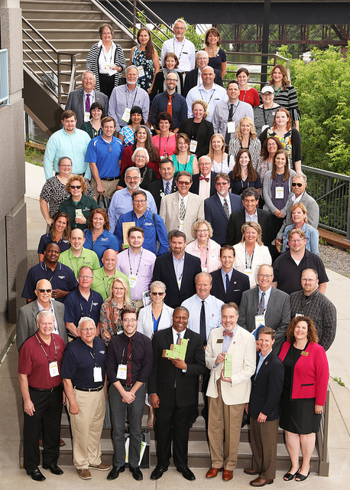
Key Program Elements
Voluntary; self-paced
Free to join
Technical assistance
Recognition by peers (LMC)
Continuous improvement
framework
175 possible actions grouped
into 29 best practices
www.MnGreenStep.org
Notes:
Except for higher levels of recognition, no required actions
Recognition by your peers: League of MN Cities

Slide 4
Key Program Outcomes
128 cities, 3 tribes: > 50% of MN cities over 5,000 are a GS city
47% of MN’s population; 15% of MN’s cities
Big (300,000) & small (260)
Non-partisan acceptance
Urban and rural
4,100 best practice actions recorded
$8.4M/yr. savings (30 cities)
www.MnGreenStep.org
Notes:
Rorschach test!
25% voted Republican

Slide 5
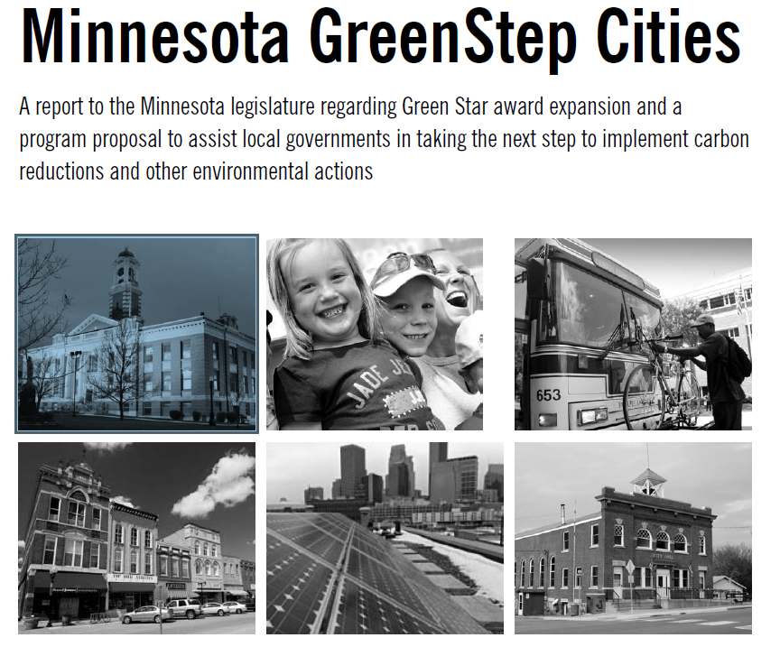
Developed by and for MN Cities
2007: “Green” Star City concept emerges @ CERTs, GPI, Hunt Utilities Group
2008: Legislature asks for a report
2009: Advisory & technical committees convened
2010: Program launch @ League of MN cities conference
2012, 2016: Awards from Environmental Initiative, U of M (State Gov. Innovation)
2016/17: City metrics
Message from cities: ‘deal with more than climate / energy’
Notes:
Initial Next Generation Energy Act (of 2007 – signed by Pawlenty) focus
LMC urged a broad focus on environmental sustainability
Action reports and metrics that measure the aggregate impact of completing multiple actions

Slide 6
GreenStep Partners: provide 4 full-time staff
Main Partners:
League of Minnesota Cities
3 State Agencies: MPCA, EQB, Commerce
Great Plains Institute
Clean Energy Resource Teams (CERTs @ UofM)
3 other non-profits:
Izaak Walton League – MN Division
Urban Land Institute – MN, & Regional Council of Mayors
Preservation Alliance of Minnesota (now Rethos)
www.MnGreenStep.org
Notes:
- thanks to LMC, couldn’t do GSC w/o you
- no partner would have done this alone

Slide 7
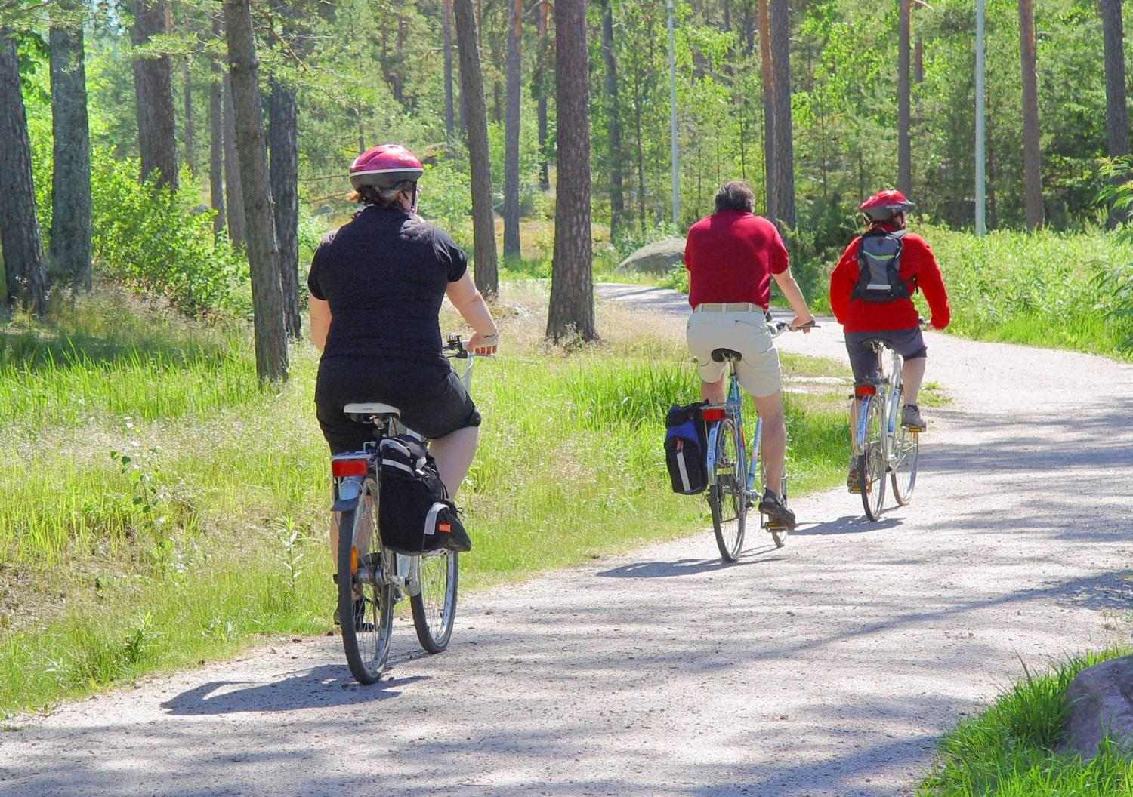
GreenStep: like a weight loss program, like Tree City U.S.A.
We join ‘programs’ so that we can:
pay more attention, be intentional, accelerate action, get assistance
document progress
share progress with community
learn from peers
be recognized by peers
choose our own path
proceed at our own pace
www.MnGreenStep.org
Notes:
Can go alone but…

Slide 8
Notes:
Example of a city using GreenStep program framework
GS a public transparency tool
From mid-MN, pop. 950, first GS city

Slide 9
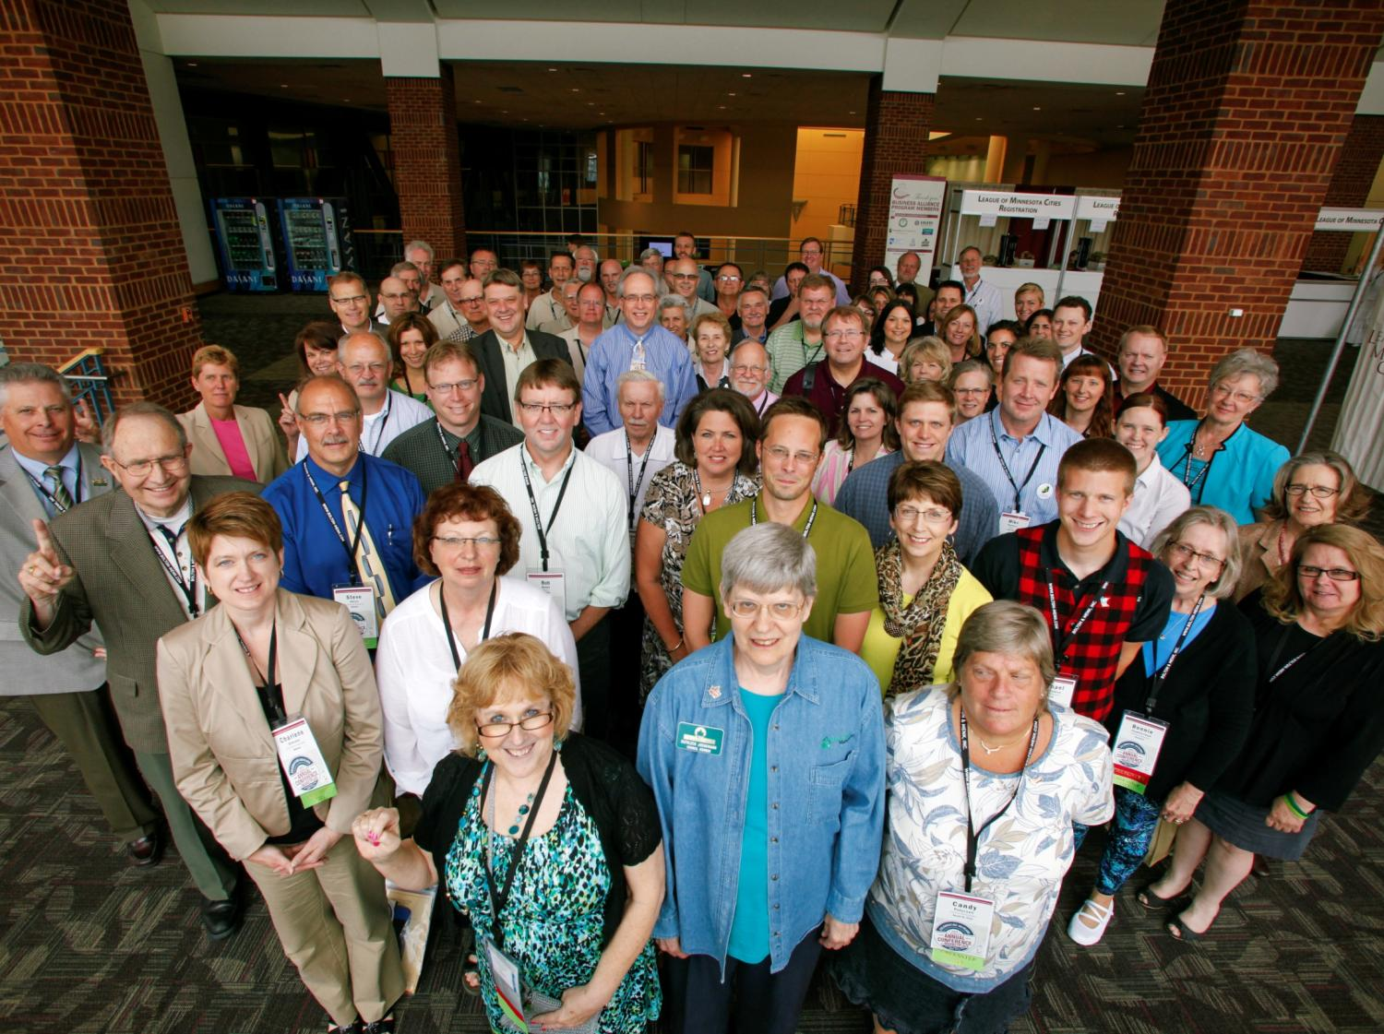
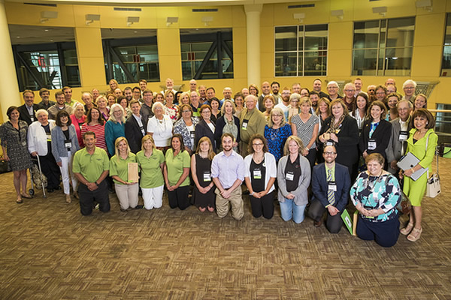
Why Cities Join: survey results
Cost Savings: spend
same $ better
Peer Recognition
Framework built
around more than
environment
Support for staff – save
time on research
Structure for civic groups,
commissions
www.MnGreenStep.org
Notes:
Annual survey / TA offering
City coordinators from 2016 LMC conference
Accelerate taking actions

Slide 10
City Perspective
“We are being rewarded for a bunch of common sense steps
and they are saving us money, they are saving us effort,
and yeah, they are having a positive effect on the environment.
They work all together, none of this is mandatory,
none of this is being driven by any kind of state mandate
— this is just looking at where we waste as a city
and where we can be more efficient and take steps to do that.
This is a really great program.”
-- City council member Mike Franklin
Notes:
Over 40 newspaper articles/yr.
Circle Pines CM July 2019:
Goldberg noted that by joining the program, “It makes our citizens aware of the good work we are doing and it puts sustainability on our radar and forces us to continue to look at it, analyze it and think about what we want to do moving forward.”

Slide 11
Program Elements
Best practices: 29
BP actions: 175
Action rating: at 1,2,3 Stars [good, better, best]
Recognition levels:
Step 1: join
Step 2: complete any 8 BPs [8 for A cities]
Step 3: complete 16 BPs with a few high priority ones
Step 4 : report city performance metrics
Step 5: show metric improvement
City categories [capacities]: A, B, C
www.MnGreenStep.org
Notes:
‘rules of the road’

Slide 12
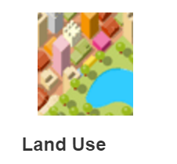
Best Practices
Public Buildings
Private Buildings
New Buildings
Lighting & Signals
Building Redevelopment
Comp Plans
City Growth
Mixed Uses
Auto-oriented Development
Design for Natural Resource Conservation
Living Streets
Mobility Options
City Fleets
Demand-Side Travel Planning
Notes:
BPs are practices that are the best of what we see in MN, best of what we want to see and what can be done by cities
29 Best practices in five categories that cities relate to
With 175 best practice actions

Slide 13
Best Practices (con’t)
Sustainable Purchasing
Urban Forests
Stormwater
Parks & Trails
Water & Wastewater Facilities
Septic Systems
Solid Waste Reduction
Local Air Quality
Benchmarks & Community Engagement
Green Business Development
Renewable Energy
Local Food
Business Synergies
Climate Adaptation & Community Resilience

Slide 14
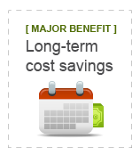
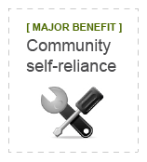
Each best practice is identified with a ‘major benefit’ accruing to cities that complete
actions under that best practice

Slide 15
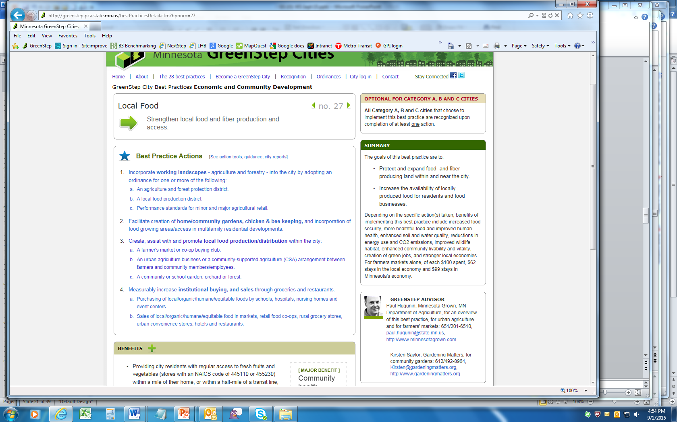
Best Practice goal
4 optional actions
Step 3 completion / recognition guidance
The argument for taking action
Documented benefits from taking action
First call for help, ideas, perspective, funding
Notes:
Common page format for each BP

Slide 16
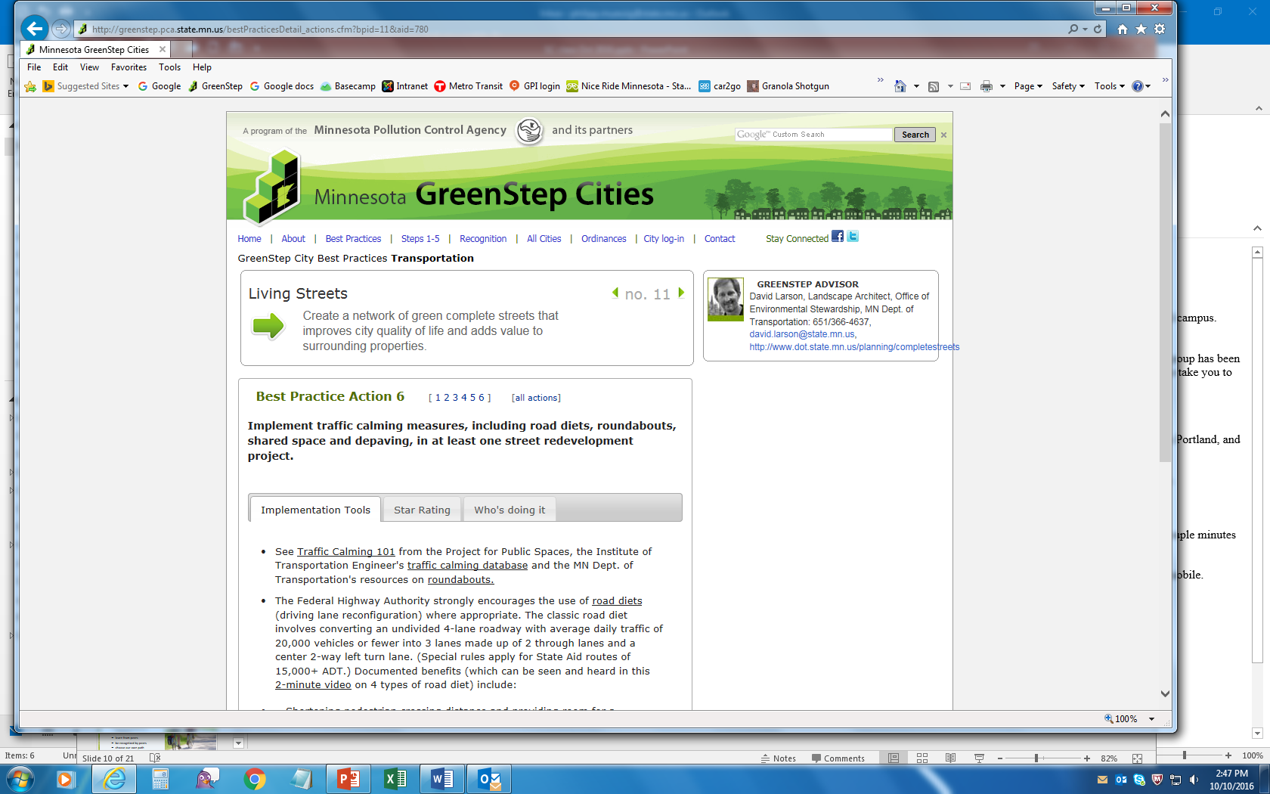
Reports from cities
Actions are of 5 types:
City policy, ordinances, regulations, incentives
Investments of $
Staffing of city assistance programs
Information/education
Collaboration
1,2,3-star completion guidance
Notes:
Format for all action pages

Slide 17
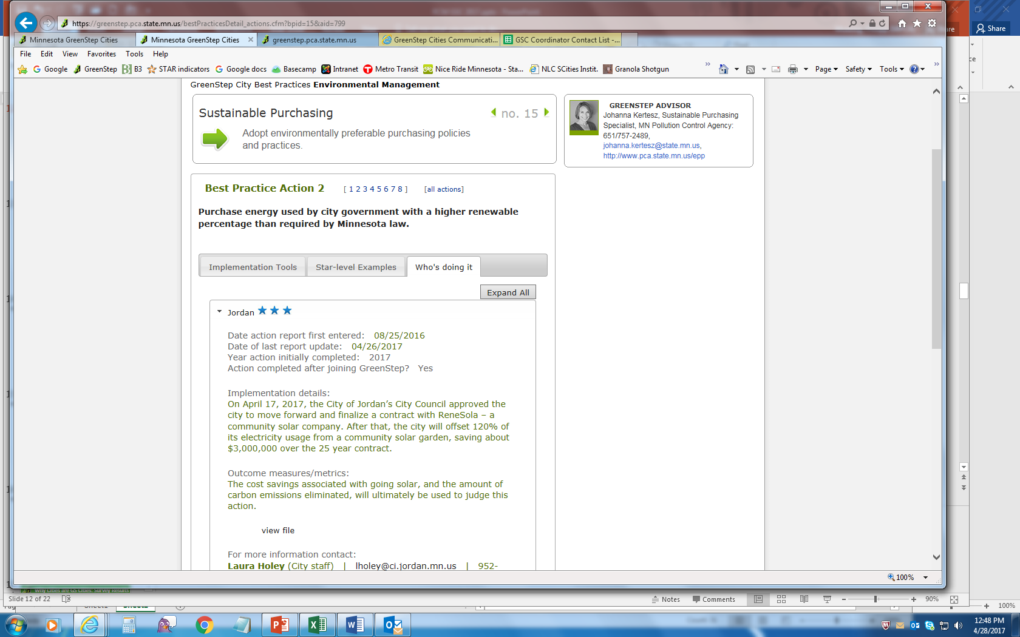
Reports from cities: peer learning
Attributes of actions:
Action vs. planning
Actions big & small
Actions to engage ‘top management:’ electeds, commissions, staff, civic groups
Notes:
Learning network for city staff

Slide 18
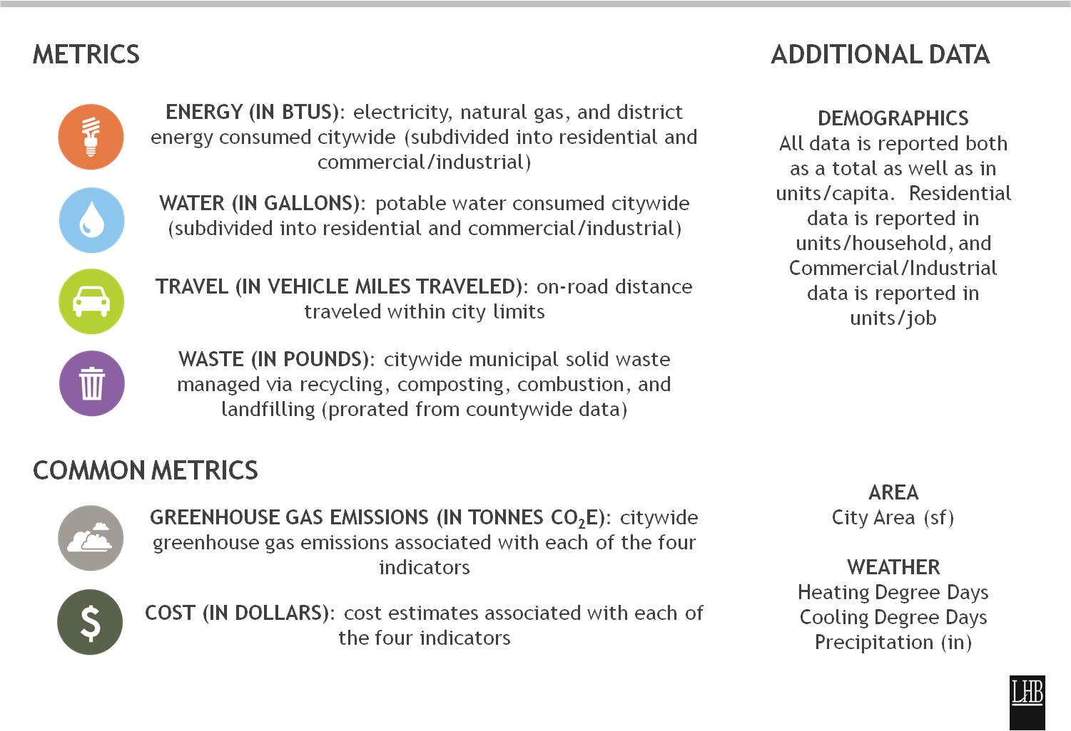
Measuring Impact: Regional Indicators Initiative
Notes:
2020: free data for all 7-county metro cities
Some data now for greater MN GS cities

Slide 19
Measuring Impact: Step 4/5 Metrics
Example: Infrastructure for Walking/Biking
% of housing within 1 mile of a bike route
WalkScore for your city or downtown
Miles of new or reconstructed sidewalks & trails last year
www.MnGreenStep.org
Notes:
2 metrics that represent the ‘sustainability level, or performance’ of the city that may not change ever year
1 metric that changes every year

Slide 20
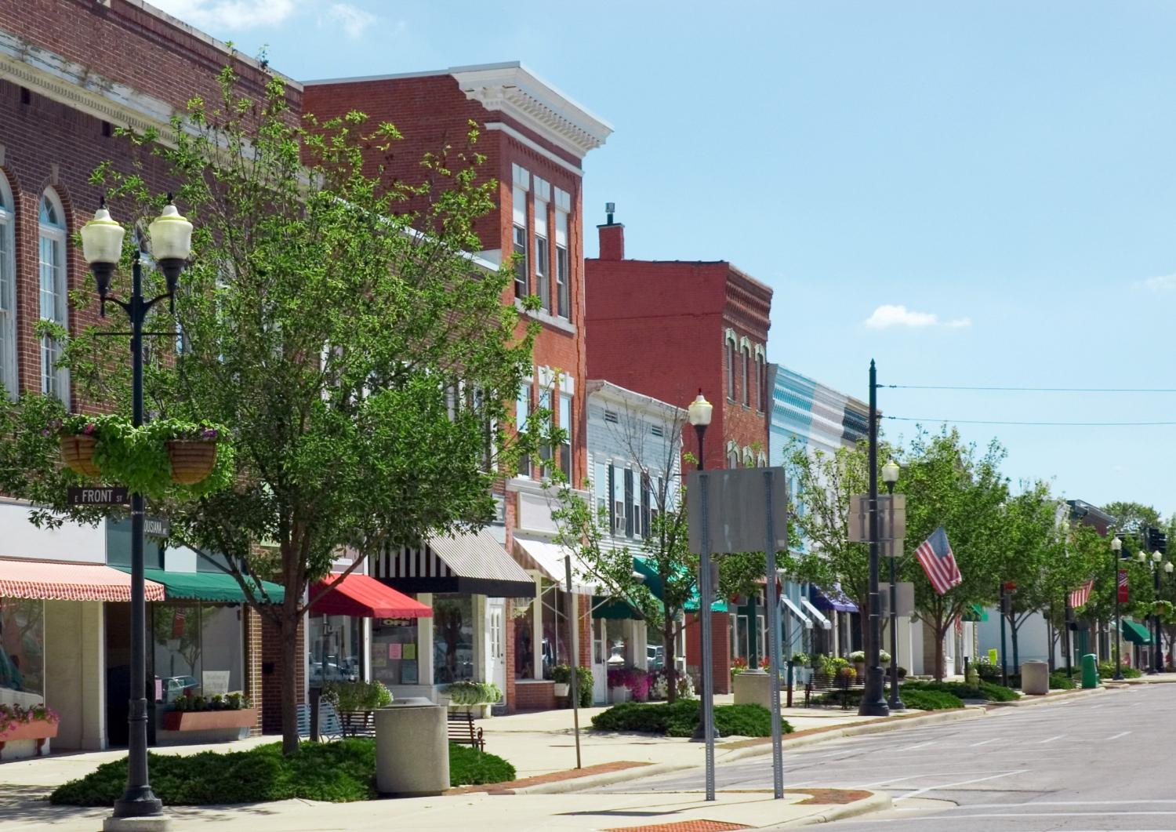
Questions, Comments
Philipp Muessig
GreenStep Cities Program Coordinator
At the MPCA
Click “Contact” on GreenStep home page
www.MnGreenStep.org

